Slide 1
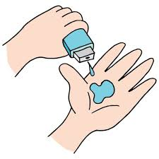
Health Care Analysis for doctor Visit
By Sawari Jamgaonkar

Slide 2

PROBLEM STATEMENT
Healthcare systems encounter major obstacles in increasing resources and guaranteeing fair access to care. To tackle these issues, it is crucial to comprehend the fundamental factors that impact the frequency of patients' doctor visits and utilization of healthcare services. This study seeks to examine a varied range of doctor visit data to pinpoint crucial drivers of healthcare utilization.

Slide 3
PROJECT DESCRIPTION
The goal of this project is to examine data from doctor visits to discover important information about how healthcare services are used. Using Python tools and libraries, we will investigate connections between patient characteristics, health conditions, insurance status, and how often patients see doctors. The analysis will involve cleaning the data, explaining the findings, and creating visual representations of the data. The knowledge gained from this analysis will support better decision-making, enabling stakeholders to develop specific interventions, enhance healthcare access and affordability, and ultimately improve the quality of healthcare services.

Slide 4
PROJECT LIFE CYCLE
Importing necessary libraries
Understanding the dataset
Data pre-processing
EDA and Visualization

Slide 5
WHO ARE THE END USERS?
Patients receive healthcare services and their well-being is the primary focus.
Clinicians engage with new healthcare technologies regularly, and their input is essential for creating effective systems.
Healthcare organization leadership supervises projects to ensure they meet goals and budget requirements.
Vendors contribute systems or implementation support as part of the project, particularly for integrations.

Slide 6
TECHNOLOGY USED
Python: For data analysis and visualization.
Pandas: For data manipulation and preprocessing.
Matplotlib & Seaborn: For creating various plots and visualizations.
Google Colab: As the development environment for writing and running the Python code.

Slide 7
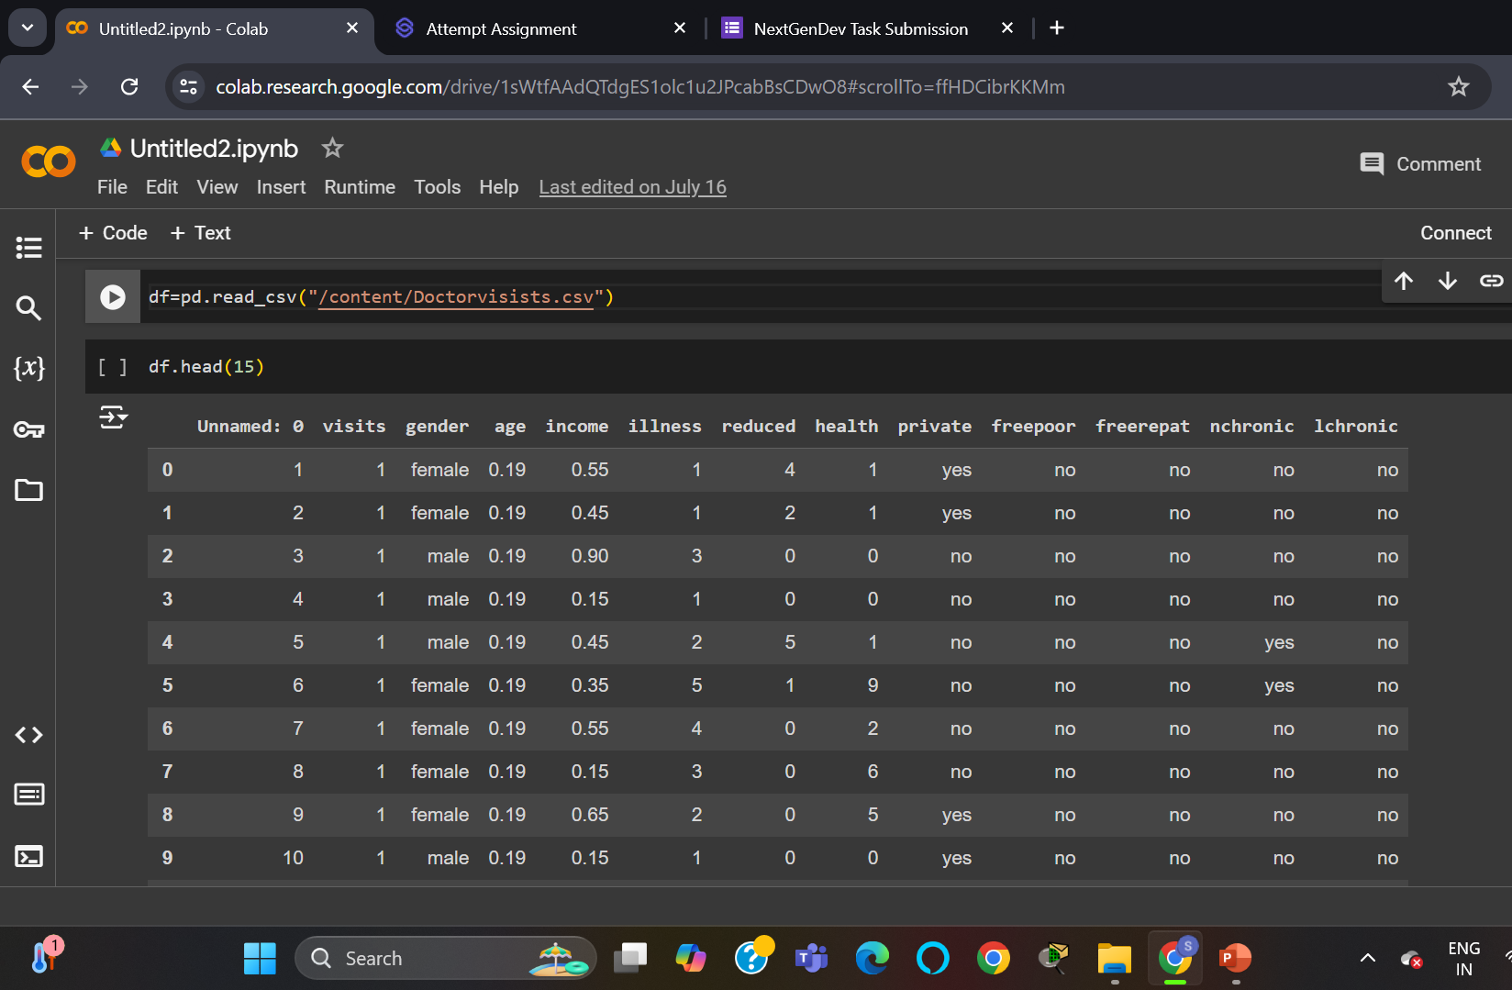
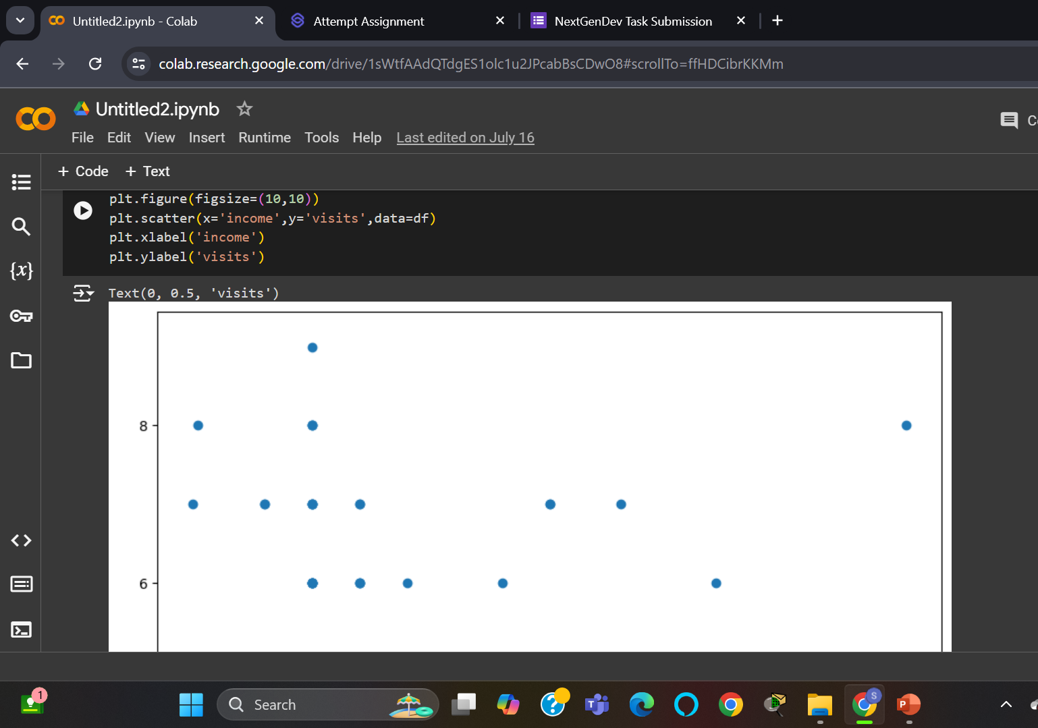
RESULTS

Slide 8
Thank you
.
.

